Slide 1
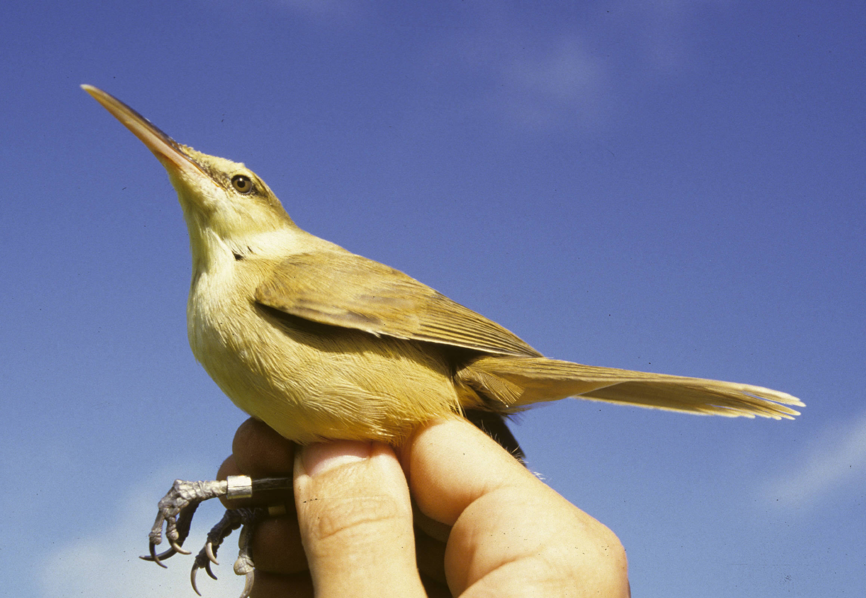
Endangered Species
Conservation
Why bother?
The history and philosophical underpinnings of endangered species conservation.

Slide 2

Excerpt from: Conservation of Endangered White-eyes of the Tropical Pacific.
Every endangered species needs a champion, especially if it is a little green one that few have heard of and less have seen. White-eyes are neither sexy nor macho, and all of the usually invoked reasons for preserving endangered species would not seem to apply here (i.e. white-eyes do not cure cancer). The only way that such species are likely to persist is through the action of motivated individuals.

Slide 3
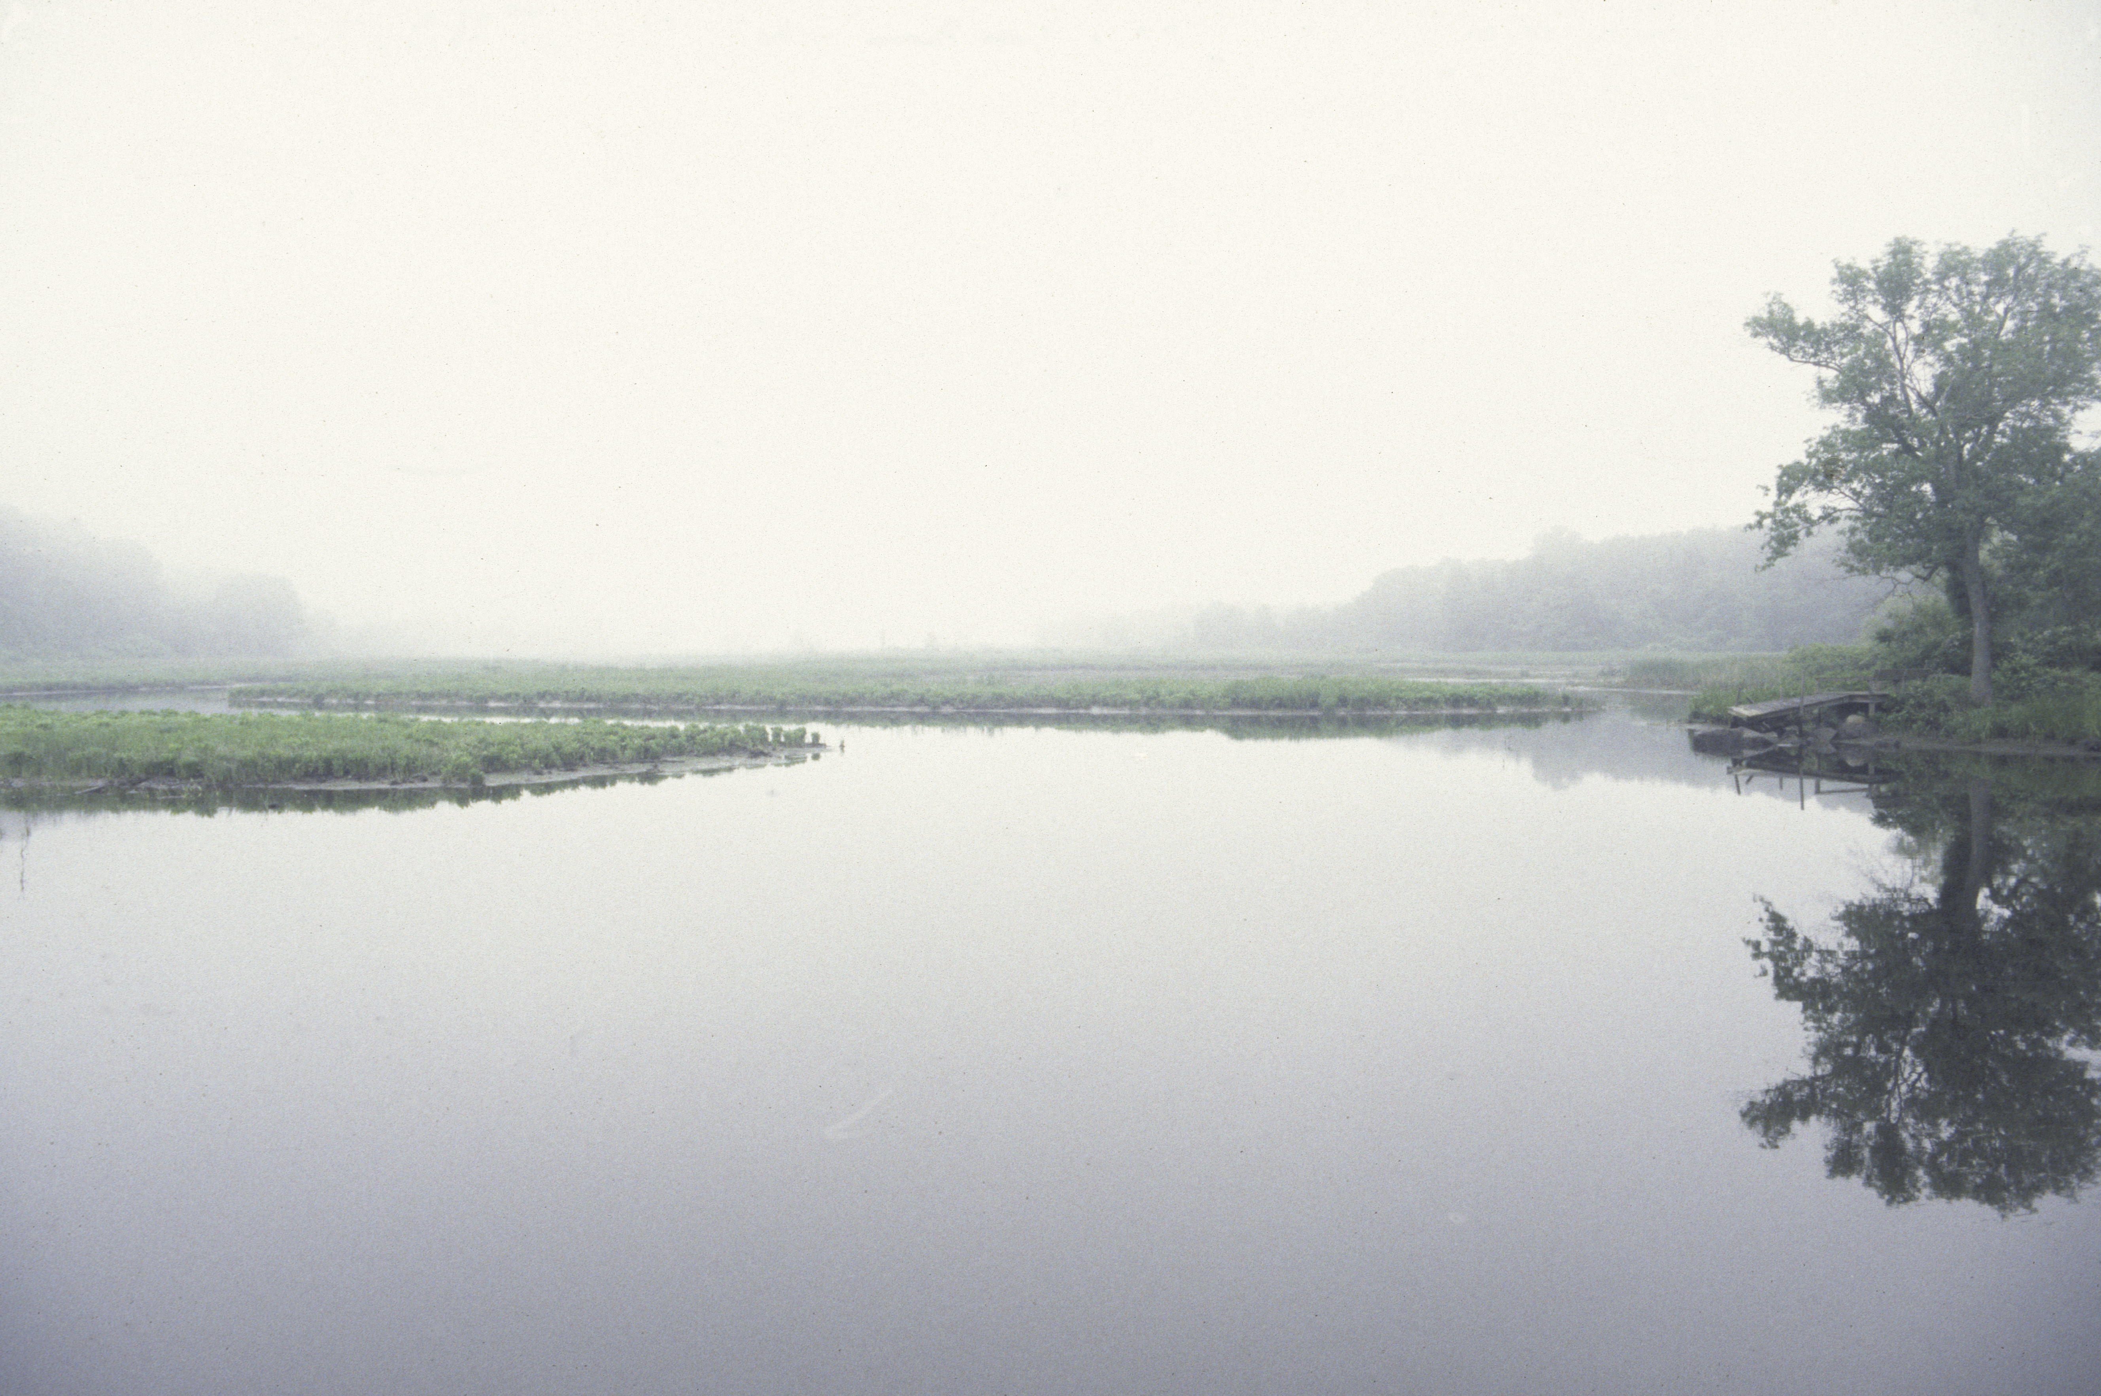
Objectives
To consider the historical beginnings of endangered species conservation, particularly with respect to North America.
To identify and evaluate arguments presented on behalf of endangered species conservation.

Slide 4
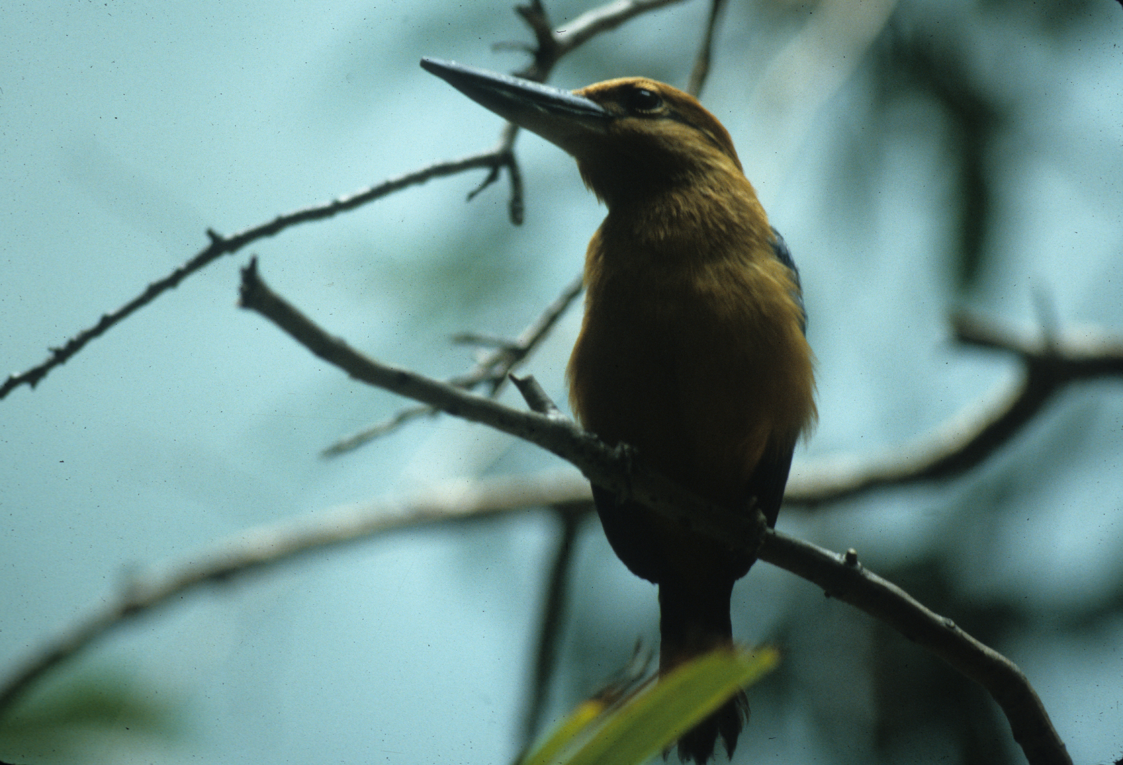
Prehistory
Early humans exerted a profound influence on their environments, changing them, for example, from forest to parkland and grassland via burning.
Paleontological evidence indicates that hunting and habitat change contributed to the mass extinctions of terrestrial megafauna at the close of the Pleistocene.
On islands, where isolation has led to the evolution of endemic, competitively and immunologically ‘naïve’ species, human arrival even on supposedly pristine Henderson Island yielded extinction of greater than half of the original fauna.
Case study: Saipan, Mariana Islands:
  There are presently 4 native species of small land birds on the island.
  However, before human arrival, there was also a parrot-finch, Myiagra flycatcher, Monarcha flycatcher and giant white-eye. Related species still survive on other islands, particularly Palau.
  These extinct species were ecologically similar to the surviving species- How did they co-exist?
The Guam Kingfisher, a member of the more widespread Micronesian Kingfisher ‘superspecies,’ is an endemic island form that survived into historic times. It is now extinct in the wild- a consequence of the introduction of the predatory Brown Tree Snake during the 1940s.

Slide 5
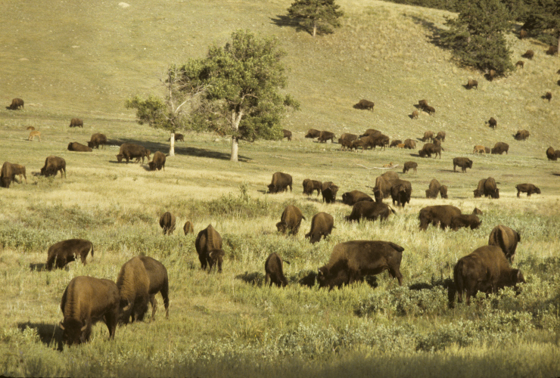
19th Century North America
Although prehistoric humans had already been responsible for wholesale environmental change in North America, European arrival even more profoundly altered the environment through hunting, logging and agricultural conversion of entire landscapes.
Market hunting all but eliminated the American Bison, once numbering 30 million.
Market hunting and logging also drove the Passenger Pigeon to extinction, which was once perhaps the most abundant bird in the world at up to 5 billion individuals.
The abundance of these species ensured that they exerted major impacts on their environment, influencing plant community composition and, hence, the populations and composition of animal communities. They were so-called keystone species.
Female and calf herd of American Bison
During the 19th century, the morality of such wholesale slaughter began to be questioned. The National Association of Audubon Societies was an early organization formed with conservation as a principal mission.

Slide 6
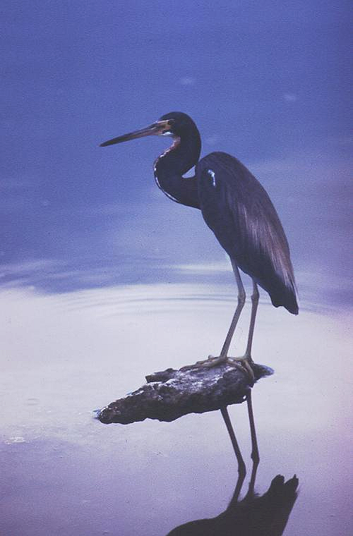
The Plume Trade
Beginning in the 1870s, the millinery industry popularized the use of feathers in women’s hats.
The elaborate courtship plumes of wading birds such as herons and egrets were favored, reaching a value on par with gold.
Birds were killed at their breeding sites (heronries, not ‘rookeries’) at the rate of 5 million/year.
Because breeding site were targeted, eggs were not incubated and hatchlings died from starvation and predation, thereby drastically curtailing population recruitment.
North American populations plummeted, such that by 1900 remaining heronries were primarily in remote areas of the deep South, such as the Florida Everglades.
Tricolored Heron

Slide 7
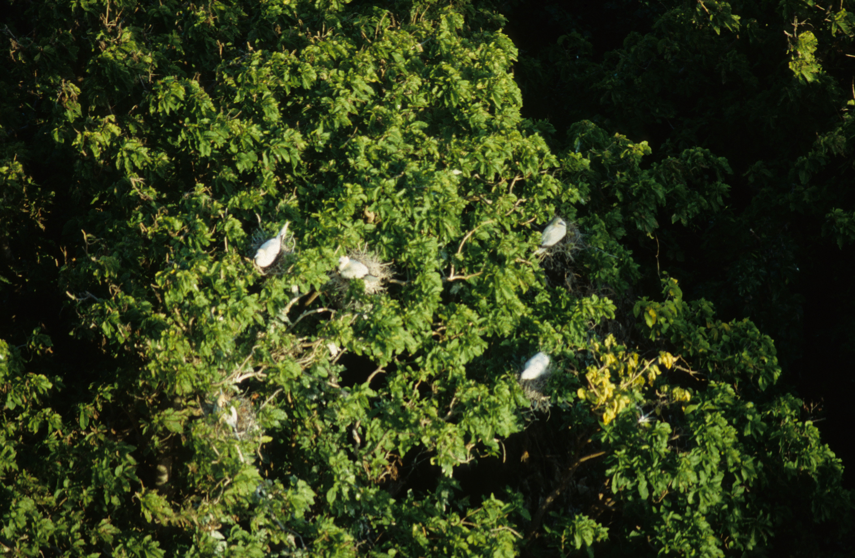
Blue-footed, Red-footed and Brown Booby colony
Plume trade-continued
Beginning with the 1900 passage of the Lacey Act, which prohibited trade in illegally hunted wildlife, laws were enacted to protect bird breeding sites and to prohibit the plume trade.
The 1903 executive order protecting the heronry on Pelican Island, Florida was the beginning of the National Wildlife Refuge system.
The 1905 Florida killing of Audubon game warden Guy Bradley turned public opinion against the plume trade.
Although the plume trade ended, even into the 1970s wading bird populations were still recovering.
In southern New England, species like breeding Yellow-crowned Night Herons were just starting to re-appear.
In New Jersey, the Black-necked Stilt and Brown Pelican were also starting to re-appear for the first time since Audubon’s observations in the 1830s.

Slide 8
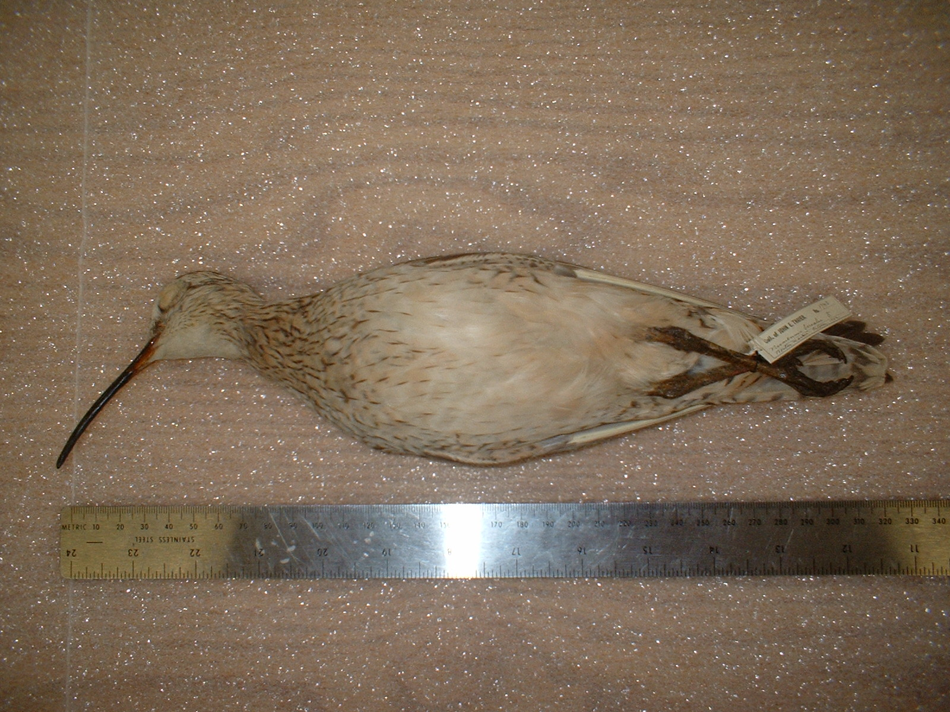
Migratory Bird Treaty Act of 1918
First enacted in 1916 to stop the unregulated hunting of migratory birds.
Shorebirds (right), waterfowl, plume birds and hawks were hunted heavily, particularly during spring and fall migration.
The act grants protection to birds, eggs, feathers and nests.
In addition to ending market hunting, it ended the Victorian pursuits of amassing collections of bird skins, eggs and nests.
Populations were still recovering from hunting well into the 1970s and some species have never regained their former abundance.
1902 Eskimo Curlew purchased at the Boston game market.
Snipe, woodcock, grouse relatives, rails and doves remain legal gamebirds, as do most waterfowl, with take regulated by state laws.
Permits are required for all other taking of migratory birds and their parts.

Slide 9
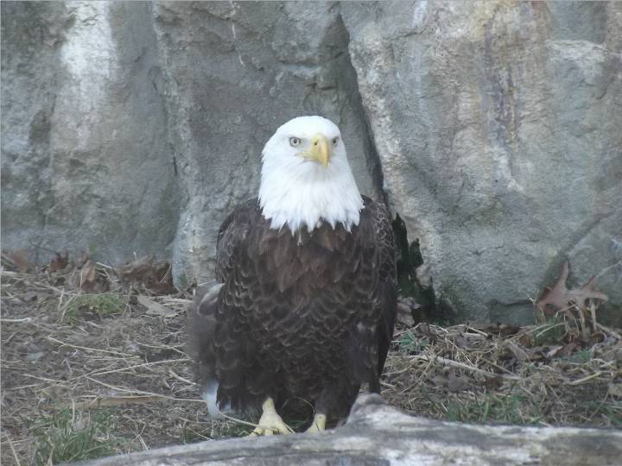
Endangered Species Act of 1973
Provided protection for endangered plants and animals and the ecosystems upon which they depend.
Expanded upon the earlier Endangered Species Protection Acts of 1966 and 1969, which permitted listing of species as endangered, prohibited trade in endangered species and considered all terrestrial vertebrates as well as certain invertebrates.
Provided categories of endangerment: endangered, threatened and candidate species.
Listing was based solely on scientific data and dependent upon meeting such criteria as habitat threat, overharvest, decline due to disease or predation and inadequate regulation.
Established critical habitat (habitat features required by endangered species) criteria, as habitat loss was recognized as the principal threat to species.
Required recovery plans- requires preparation of a plan to develop a path to population recovery.
The Bald Eagle, once down to 412 pairs in the contiguous 48 states, was de-listed in 2007.
Developed habitat conservation plans- in 1982, a provision was added that encourages protection of species on private land while allowing for commercial activity.

Slide 10
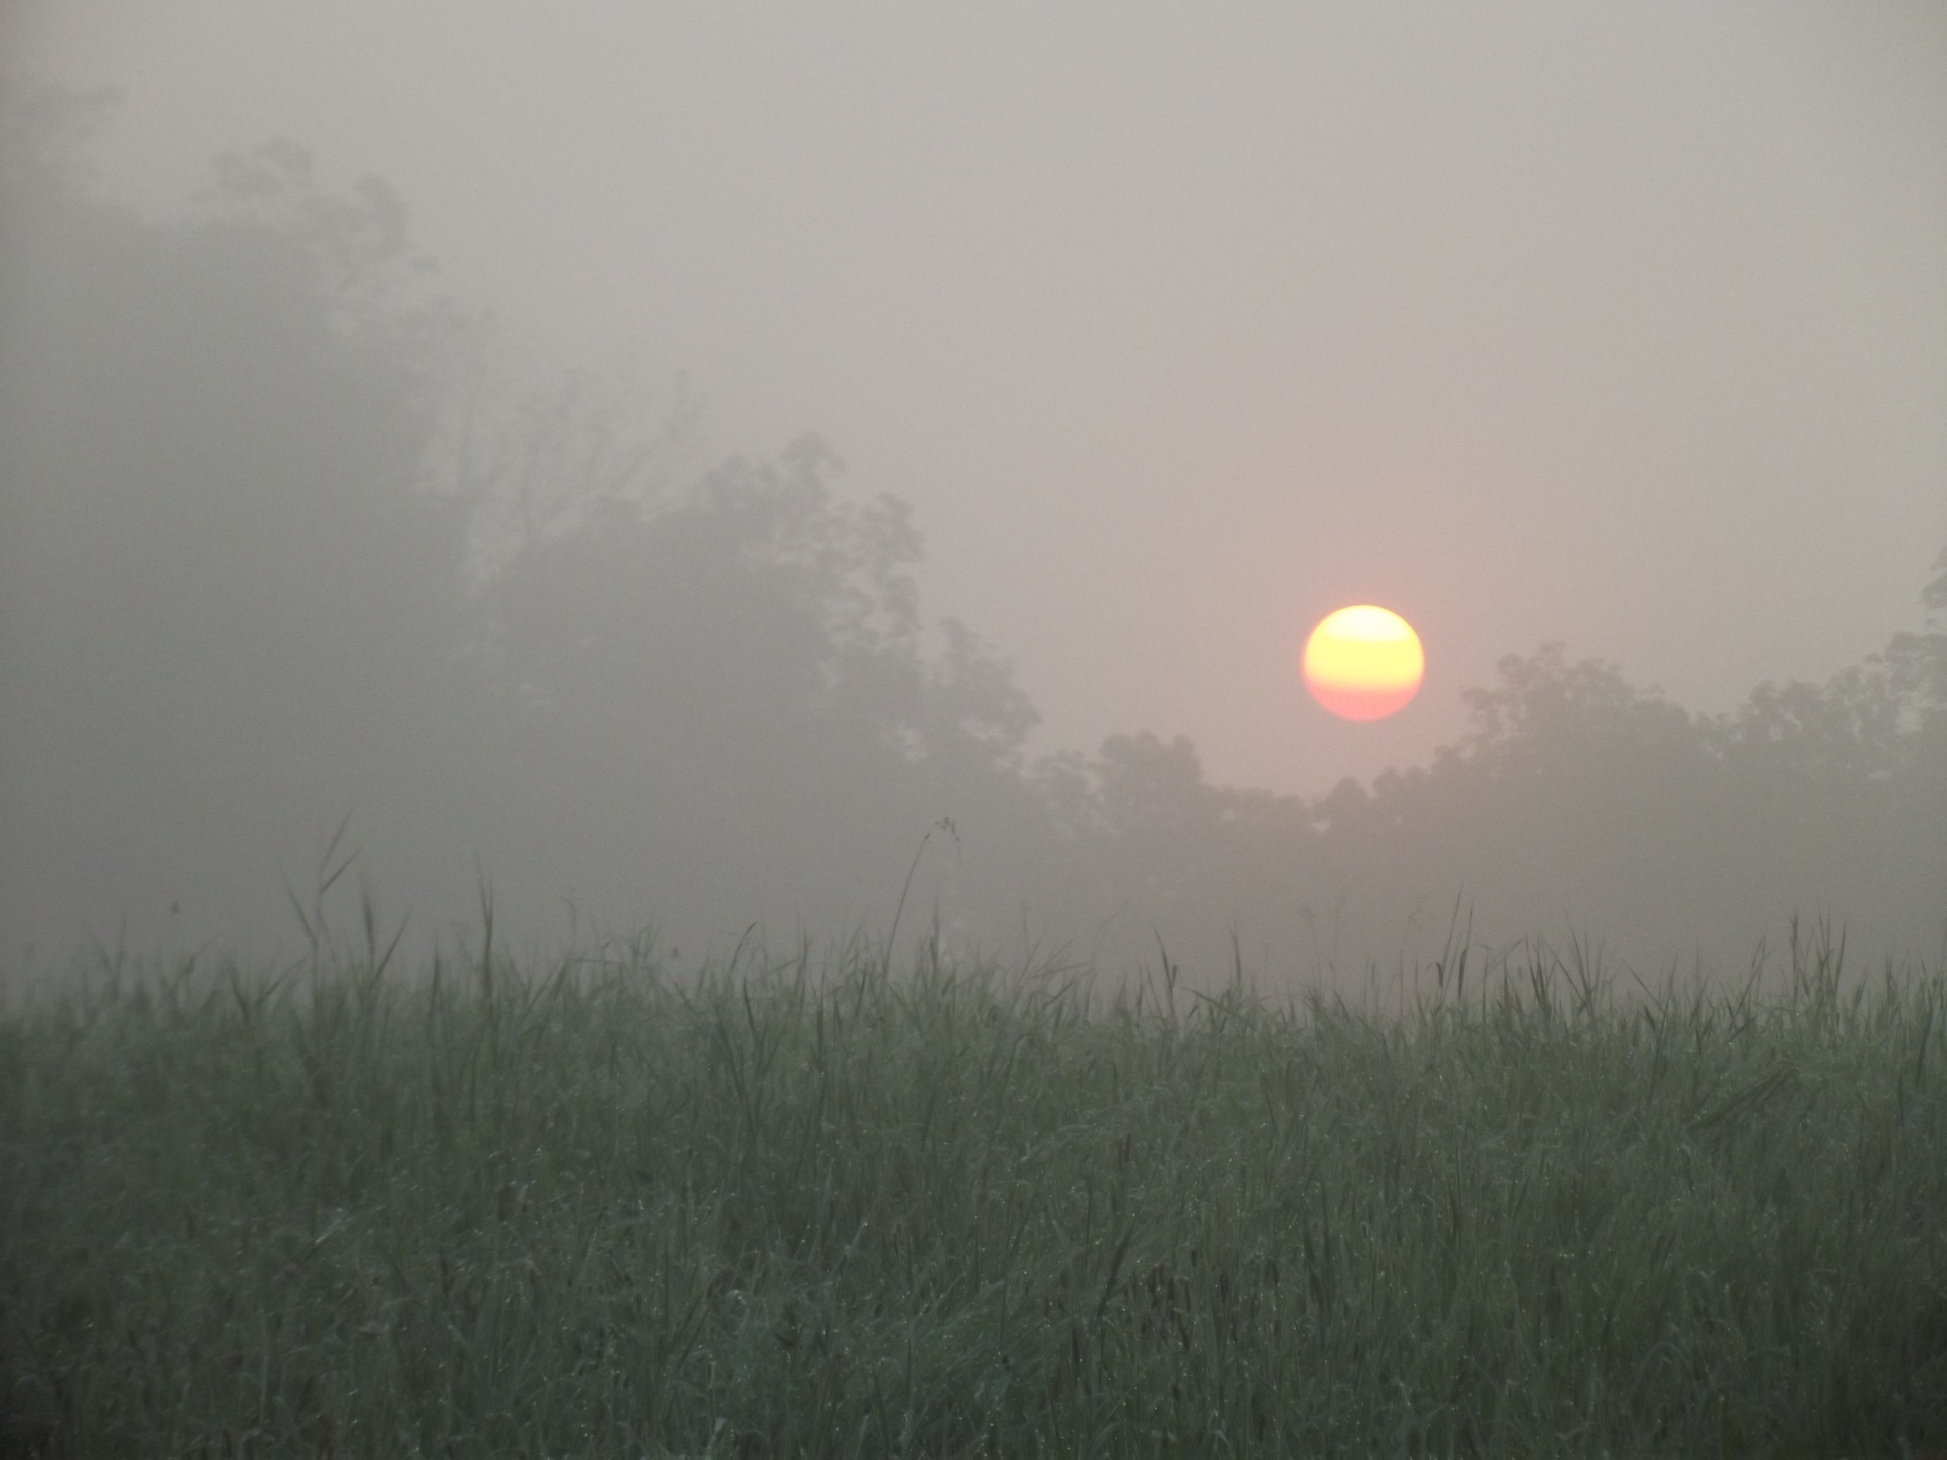
Why Protect?
Genetic and biochemical reservoirs- genetic and, therefore, biochemical diversity provides a resource for medicine and agriculture to draw upon.
Agriculture- in addition to serving as a source for new crop species and genetic material to insert into existing crops, it is argued that biological control of agricultural pests is based on the diversity of surrounding natural systems.
Bio-indicators- when species undergo population declines, they may provide evidence for environmental degradation.
Reasons proposed include the role of all species in:
Ecosystem function:
  Biogeochemical cycling- the trophic cycling of nutrients from producers to consumers to decomposers.
  Ecosystem stability- the view that communities are tightly integrated assemblages; hence, removing species makes systems less stable.
  Ecosystem services- the view that ecosystems provide services of human value. These include the flood control value of wetland systems, food production and O₂ production by primary producers.

Slide 11
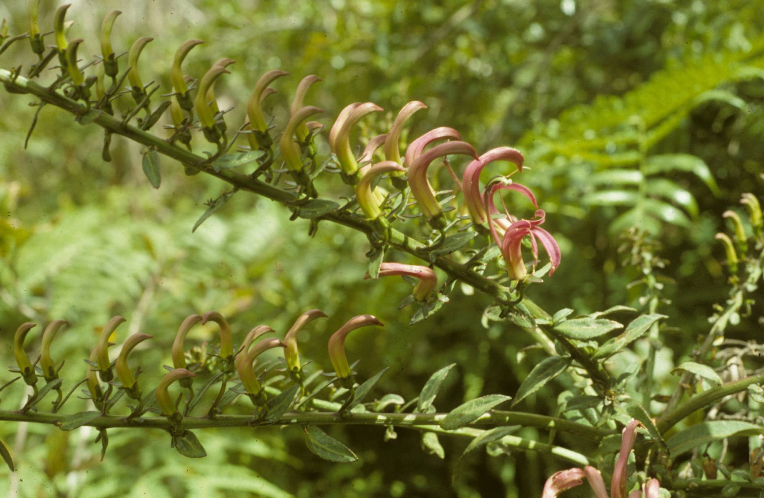
Values- continued
Academics- All species are elements of systems that provide opportunities to understand ecosystem relationships, physiological mechanisms and evolutionary relationships.
Recreation and economics- in addition to providing ecosystem services, species generate great interest among people, which translates to recreational and economic value.
Historic and aesthetic value- all species are part of the story of humanity. Humans have interacted with other species since prehistory and so are culturally connected to them. The sense of the aesthetic is integral to humanness.
Kaua’i False Lobelia (Trematolobelia kauaiensis)- a member of the diverse, endemic Hawaiian lobelioids, all of which are derived from a single founder species arriving 13 million years ago. Many are endangered or presumed extinct due to habitat degradation and the activities of introduced predators.

Slide 12

Evidence for Protection Arguments
Agriculture- Agricultural monocultures are notoriously vulnerable systems, and ample evidence exists for natural communities adjacent to agricultural land being sources of biological control agents. However, although this is an argument for preservation of natural diversity, it is not necessarily one that applies to rare species.
Bio-indicators- population declines, particularly rapid declines of keystone species, is clear evidence of an environmental perturbation with potentially significant human consequences. For example, the rapid population collapse at the turn of the 20th century of the American Chestnut- a keystone species of great commercial value- fundamentally altered the North American temperate seasonal forest biome and had immense economic consequences.
Ecosystem function-
Such arguments are best made on behalf of keystone species, but are not likely to be substantive for otherwise rare species.
Diversity does not necessarily equal ecosystem stability. Low diversity tundra systems may be said to be stable, for example.
Ecosystem services- these may be properties of communities to a value estimated at $33 trillion/ year. but the extent to which rare species contribute to these is likely to be small.
Genetic/ biochemical reservoirs- any species is a potential reservoir, but the likelihood that a particular species is important is low. This argument is perhaps strongest for wild ancestors of agriculturally important species.

Slide 13
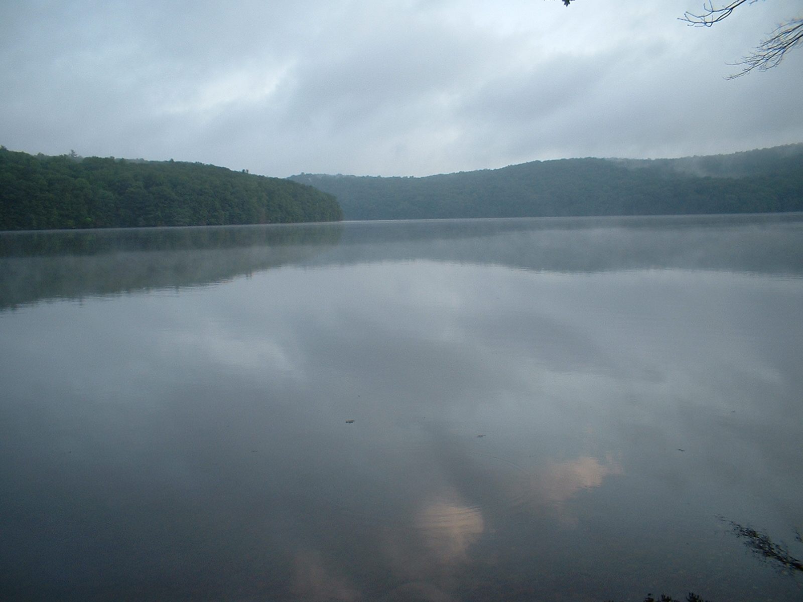
Evidence- continued
Academic- all species are of significance to biological investigations.
The manner in which species evolve to fill environments and how they interact with their physical and biological environments are all aspects of inquiry that lead to basic scientific understanding.
Loss of any species diminishes our ability to investigate these questions.
Understanding basic science is central to developing applied science.
Recreational and economic- these values have been estimated to be in the billions of dollars worldwide. Nature tourism, for example, is a major industry.
Historic and aesthetic value- this is perhaps the real reason behind our motivation to protect- it flows from the human senses of aesthetics, community and ethics- our capacity to appreciate gives rise to a sense of responsibility toward being stewards of the environment- key underpinnings of human civilization. The sense of the aesthetic also gives rise to recreational and economic values.

Slide 14
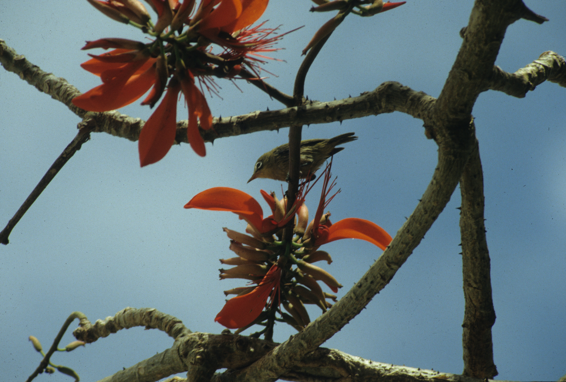
Excerpt from: Conservation of Endangered White-eyes of the Tropical Pacific.
In order to survive, every endangered species may need a champion, but why bother? This is the unpleasant question that most of us consciously or unconsciously avoid, or choose instead to hide behind transparently weak dogma when we must think about it. Do we really believe that a few hundred tiny birds on some remote dot might hold the key to ecosystem stability? How many of us believe that within the bodies of white-eyes lies the undiscovered chemical that will cure all the ills of mankind? So why do we do it?
Probably like some of you, I am a great fan of music. For some peculiar reason, probably related to the reason that I so adore little green birds, I love especially rather obscure compositions like Handel’s operas. Now, despite the fact that about as many people listen to these operas as have seen Rota White-eyes, it has occurred to me that if the last page of the last copy of one these operas were lost, it would break my heart. Popular or not, these works define our humanity. Their creation testifies to our sense of the aesthetic, of our capacity for being moved by the sublime. Intelligent, bright-eyed little beings like these birds, so filled with their exuberance for life, quite fall within the realm of the aesthetic. Certainly the loss of any of these beings, who first conceived of melody and harmony, of counterpoint and fugue, would also be far more than enough to break my and likely your hearts. I do not think we need to look further for reasons to protect them.
Rota White-eye feeding from Erythrina flowers

